Slide 1



International Conference on Innovations in Science, Engineering and Technology 2024 (ICISET 2024)
International Islamic University Chittagong (IIUC), Kumira, Chattogram, Bangladesh
26-27 October 2024
Paper ID: 525
Tittle: Visualizing Crop Disease Detection Exploring Deep Learning with Custom CNN Model and XAI for Enhanced Interpretability
Md Fahim, Md Zia Ul Hassan Chowdhury, MD Jiabul Hoque, Mohammad Nadib Hasan, Hassan Jaki, Ahmad
Dept. of Computer and Communication Engineering (CCE),
International Islamic University Chittagong
Chittagong, Bangladesh

Slide 2


Table of Content
Introduction
Problem Statement
Literature Review
Result & Evaluation
Motivation and Goal
Conclusion
Future Scope
Objective
Proposed Methodology
Date: 27 October 2024

Slide 3
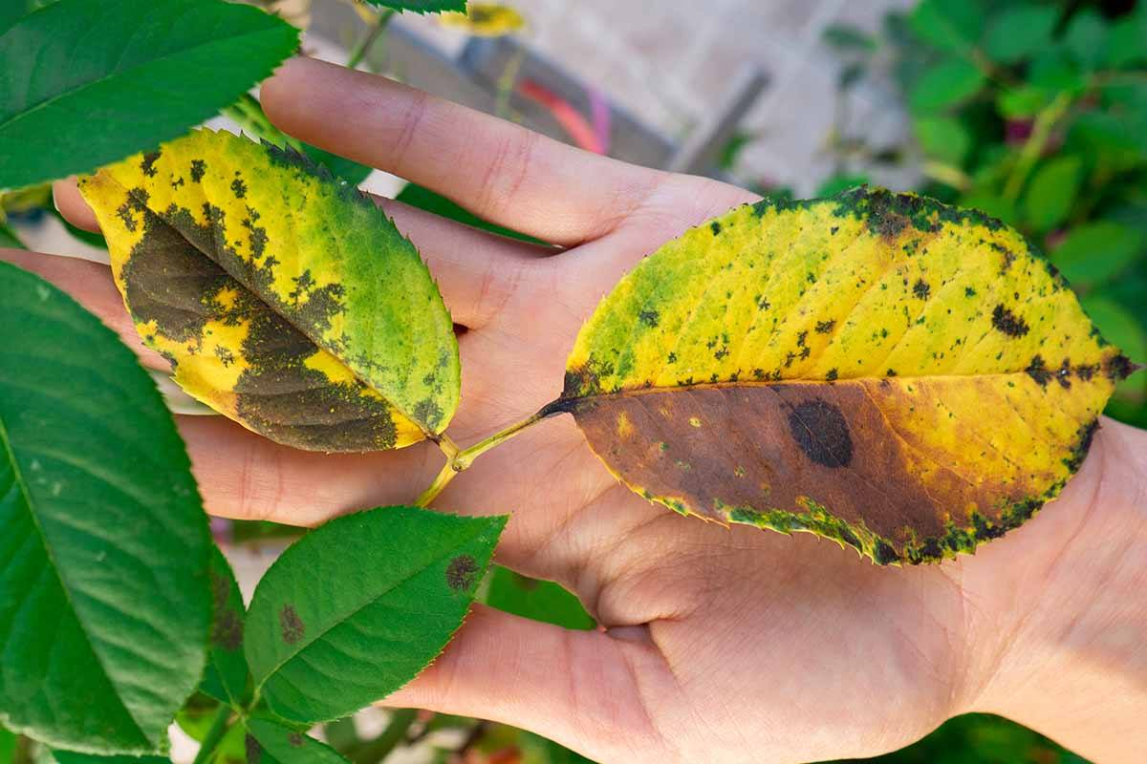
INTRODUCTION
Significant Crop Losses
Annually, 20% to 40% of global crop production is lost to pests.
Resulting in 220 billion dollars in economic losses [nifa.usda.gov].
AI in Agriculture
Artificial Intelligence (AI) is increasingly being adopted in agriculture.
Machine Learning (ML) and Deep Learning (DL) models are
used to detect and diagnose plant diseases.
Advantages of AI
AI, particularly deep learning through convolutional neural networks (CNNs), offers the ability to analyze complex data like images, enabling early and accurate detection of plant diseases.
Challenges and Collaboration
The adoption of AI in agriculture faces challenges that require interdisciplinary collaboration and efforts to ensure access to AI tools in less wealthy regions.
Figure 0: Plant Leaf Disease Scenario

Slide 4
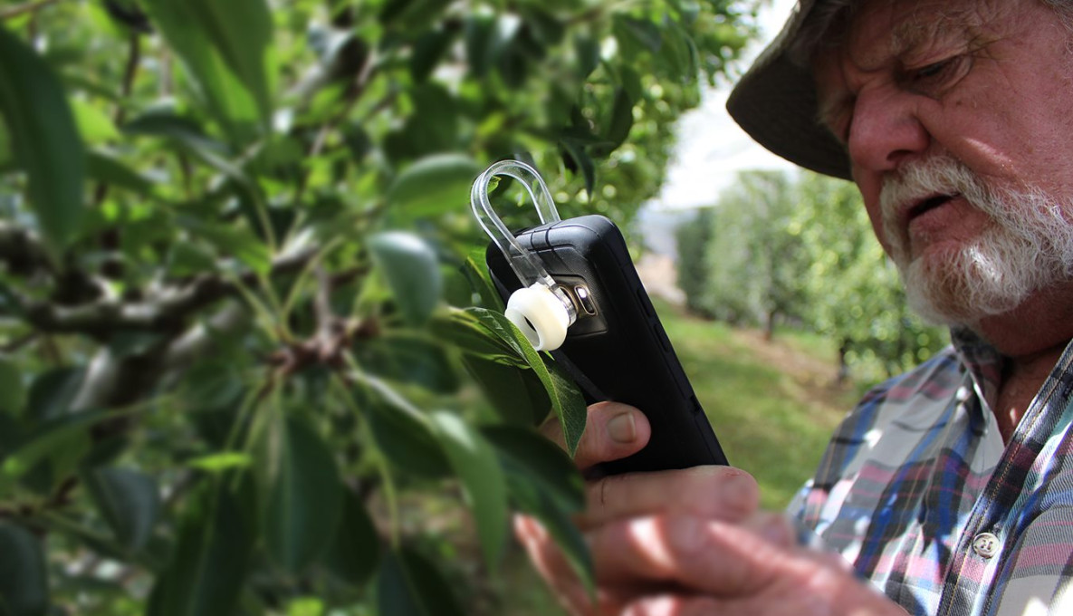
Problem Statement
Need for Accurate and Efficient Plant Disease Detection. However, there are limitations of Traditional Methods.
There are so many potentials of Deep Learning Models but Issues such as class imbalance and the need to achieve high-performance metrics (accuracy, precision, recall) remain challenges in deploying CNN models effectively.
Figure 0.1: Disease Identification Problem Scenario

Slide 5
LITERATURE REVIEW
Title | Findings | Date
Deep Learning for Plant Disease Detection Munaf Mudheher Khalid, Oguz Karan Altinbas University, 34217 İstanbul, Turkiye malmoudher97@gmail.com; oguz.karan@altinbas.edu.tr | CNN model achieved an accuracy of 89%, with precision and recall of 96% and an F1-score of 96%. The MobileNet model demonstrated an accuracy of 96%, with slightly lower precision, recall, and F1-score values of 90%, 89%, and 89% respectively. | Vol. 2024
Plant leaf disease detection using computer vision and machine learning algorithms Sunil S. Harakannanavar a , ∗ , Jayashri M. Rudagi b , Veena I Puranikmath b , Ayesha Siddiqua a , R Pramodhini a | The main finding of the paper is that the proposed model for plant leaf disease detection using computer vision and machine learning algorithms achieves high accuracy in classifying tomato leaf diseases, with an accuracy of 99.5% on a dataset of 600 samples | 2022
End-to-End Deep Learning Model for Corn Leaf Disease Classification | The results of the paper show that the proposed end-to-end deep learning model for classifying corn leaf diseases achieved high accuracy, with a classification accuracy of 98.56%. | March 14, 2022

Slide 6
Continue
Title | Findings | Date
Detection of COVID-19 Using Transfer Learning and Grad-CAMVisualization on Indigenously Collected X-ray Dataset | The paper presents a successful application of transfer learning for COVID-19 detection using chest X-ray images, with DenseNet-121 achieving the highest accuracy of 96.49%. The study also highlights the effectiveness of Grad-CAM visualization and identifies 'RMSprop' as the optimal optimizer for training. | 29 August 2021
Grad-CAM: Visual Explanations from Deep Networks via Gradient based Localization | The paper presents Grad-CAM, a versatile technique for producing visual explanations in CNN-based models, enhancing their transparency and interpretability across various tasks. Its effectiveness is demonstrated through improved localization, robustness to adversarial perturbations, and enhanced user trust in deep network predictions. | 2022
Table 1: Literature Review

Slide 7
Motivation
Enhancing Agricultural Productivity.
Ensuring Food Security.
Overcoming Limitations of Traditional Disease Detection Methods.
Goal
Our goal is to create a reliable deep-learning model that accurately detects and classifies crop diseases. This addresses the need for better agricultural productivity and sustainability through technology.

Slide 8
Objective
The primary objective of our research is to develop an advanced deep-learning model to enhance the classification of plant leaf diseases using images from the Plant Village dataset. Additionally, We applied explainable AI visualization for enhanced interpretability.

Slide 9
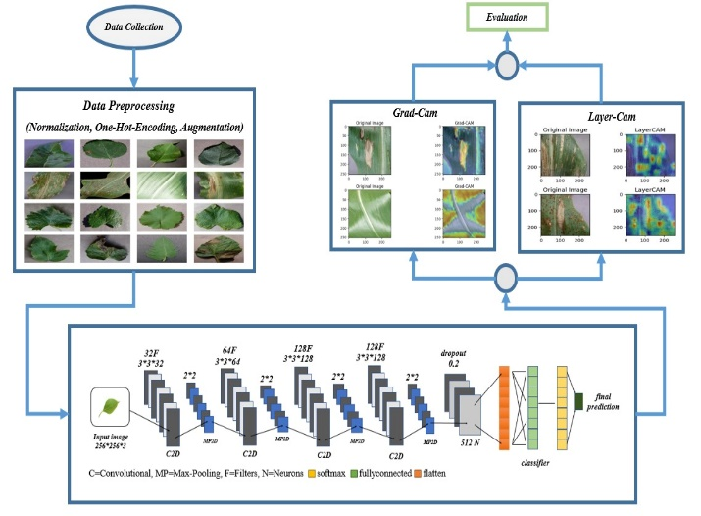
Proposed Methodology
Figure 2: Proposed Methodology

Slide 10
Data Set Description
Data Collection
For this research we have collected an image dataset of various plant diseases with healthy images.
This dataset is publicly available on GitHub, Kaggale, and other sites as the name of Plant Village Dataset.
This dataset contains 54,707 images along with 38 distinct classes.
Dataset Re-formation
For our research we have selected 16 classes from the full dataset.
We selected the 16 classes based on the availability of images in the main dataset.
Classes Names
Apple Black rot | Corn Gray leaf spot | Grape Black rot | Tomato Bacterial spot
Apple Cedar apple rust | Corn Common rust | Grape Esca | Tomato Early blight
Apple scab | Corn Leaf Blight | Grape Leaf blight | Tomato Late blight
Apple healthy | Corn healthy | Grape healthy | Tomato healthy
Table 2: Class names of the dataset

Slide 11
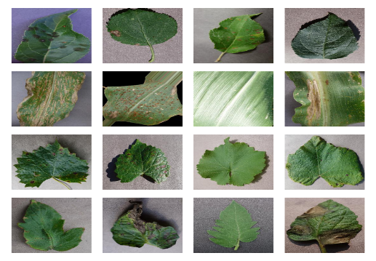
Crop-Disease Images
To prepare the dataset for the Deep Learning model we split the dataset into three different parts.
We allocate 70% of the image for training the model 20% of the image for the validation of the model and rest 10% for testing the Model.
Total Number of train images is 22,488 RGB images and for validation, 6,425 images were used and for testing the model we used 3,214 images.
For each class there are 1400 images for the train along with 400 and 200 images for Validation and Testing the model.
partition | number of images
train | 22,488
validation | 6,425
test | 3,214
Table 3: partition of data sets
Fig 1: Crop-Disease Image

Slide 12
Data Pre-Processing & Augmentation
Pre-processing
Resizing: All images were resized to a consistent shape of 256*256 to ensure compatibility with the CNN model.
Normalization: Image pixel values were normalized to a range of 0 to 1, improving the model's ability to learn efficiently.
Data Augmentation
Helps prevent overfitting
Increasing the diversity of training data.
Enhances the model's ability to generalize to unseen images.
Applied Techniques
Rotation | 40
Shear Transformation | 0.2
Zoom | 0.2
Flipping | True
Brightness Adjustment | (0.5, 1.5)
Table 4: Techniques parameter

Slide 13
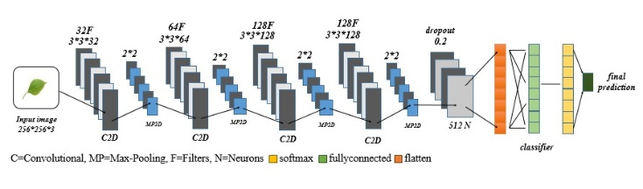
Model Architecture
Fig 3: Model Architecture

Slide 14
Continue
Input Layer
Input shape 256*256*3 representing 256*256 pixels and 3 represents RGB channel.
Convolutional Layers
Pooling Layers
Flattening Layer
Dense Layers
1st and 2nd sense layers with 512 and 16 filters and a dropout layer.
Layer No | Filter | Karnel | Act. Fn | Function
1st | 32 | 3*3 | ReLU | extracts basic features.
2nd | 64 | 3*3 | ReLU | captures more complex.
3rd | 128 | 3*3 | ReLU | focusing on high-level features.
4th | 128 | 3*3 | ReLU | focusing on high-level features.
Table 5: layer wise explanation

Slide 15

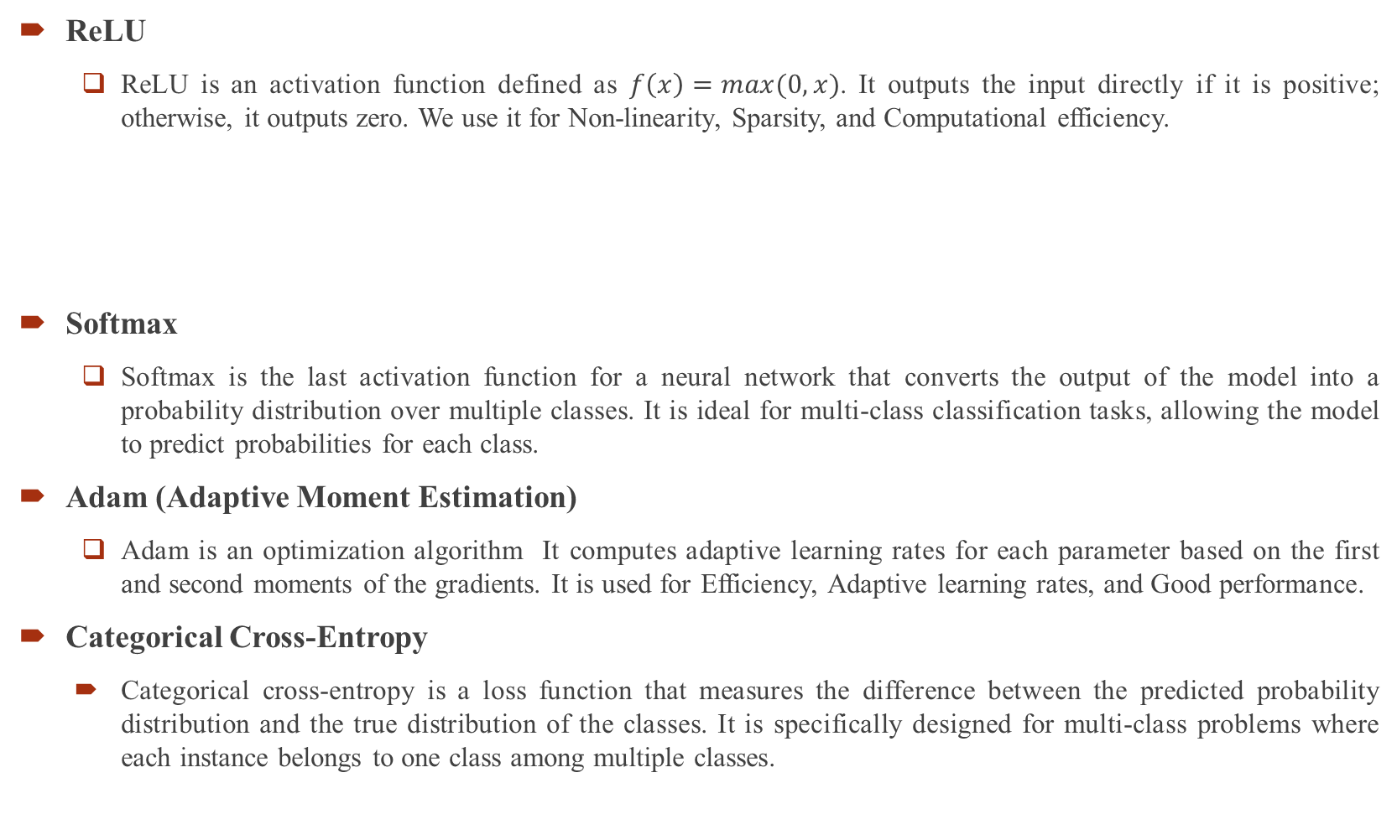
Continue
ReLU
ReLU is an activation function defined as $f\left(x\right)=max(0,x)$. It outputs the input directly if it is positive; otherwise, it outputs zero. We use it for Non-linearity, Sparsity, and Computational efficiency.
Softmax
Softmax is the last activation function for a neural network that converts the output of the model into a probability distribution over multiple classes. It is ideal for multi-class classification tasks, allowing the model to predict probabilities for each class.
Adam (Adaptive Moment Estimation)
Adam is an optimization algorithm It computes adaptive learning rates for each parameter based on the first and second moments of the gradients. It is used for Efficiency, Adaptive learning rates, and Good performance.
Categorical Cross-Entropy
Categorical cross-entropy is a loss function that measures the difference between the predicted probability distribution and the true distribution of the classes. It is specifically designed for multi-class problems where each instance belongs to one class among multiple classes.

Slide 16
Transfer Learning Models
Models | Architecture Overview | Advantage | Use case | Other Version
Inception-V3 | Expands both depth and width using "Inception modules" with multiple kernel sizes to capture features at various scales. | Efficient in handling large image datasets | Efficient for complex tasks | Inception-V1 and Inception-V2
ResNet152-v2 | Solve the vanishing gradient problem and enhance performance by refined batch normalization and activation ordering. | With its 152 layers, is effective for complex feature extraction and improves model generalization. | Capture intricate details in images. | ResNet 50, ResNet 101, ResNet151-v2
VGG-16 | Simpler architecture with 16 weight layers using alternating convolutional and max-pooling layers, small 3x3 filters. | Simple and effective in image classification | well-suited for transfer learning | VGG-19
Table 6: Overview of the TL models

Slide 17
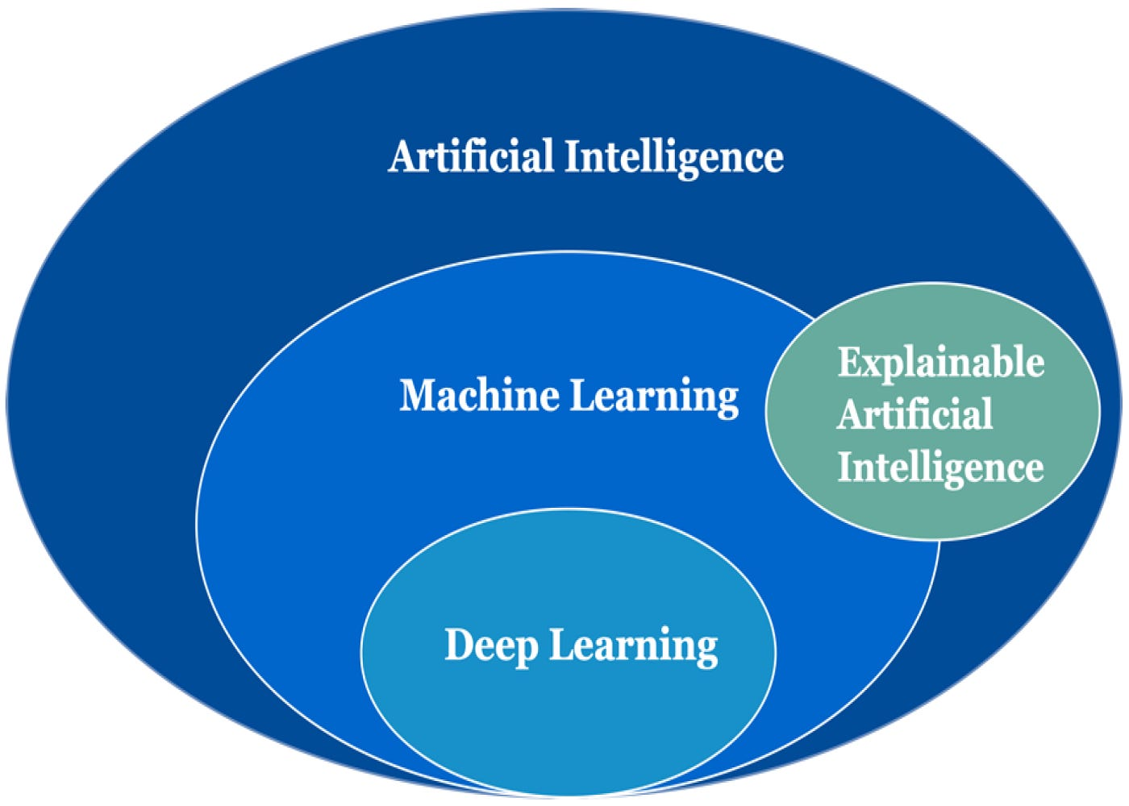
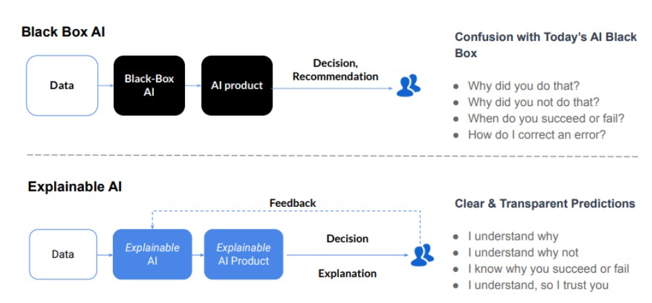
Explainable Artificial Intelligence
Explainable AI (XAI) is essential in enhancing the interpretability of deep learning models, particularly in sensitive applications such as plant disease detection. As deep learning models often operate as black boxes, understanding their decision-making processes can help build trust among users, facilitate knowledge transfer, and ensure ethical deployment
Interpretation of Model Predictions.
Identifying Areas for Improvement.
Enhancing User Trust and Adoption.
Supporting Diagnostic Decision-Making.
Facilitating Education and Training.
Figure 4: explainable AI

Slide 18
Model Training and Implementation
Training Configuration
Hard-ware Description
We have used an Intel Core i5 processor, 12GB of RAM, and Python version 3.8.15.
And we have Used TensorFlow 2.3.0 and Keras 2.4.0.
Parameter | Value/Description
Batch Size | 32
Optimizer | Adam
Loss function | Categorical Cross-Entropy
Epochs | 20
Table 7: training configuration

Slide 19
Epochs Wise Model Performance
Figure 5: model performance of proposed CNN
The model's accuracy consistently improves across epochs, starting from 43.14% in the first epoch to 95.68% by epoch 20, demonstrating the model’s ability to learn effectively as training progresses.
The training loss decreases from 1.67 in the first epoch to 0.13 by epoch 20, indicating that the model is minimizing errors and improving performance
The validation accuracy reaches a peak of 96.83% by epoch 15, indicating strong performance on unseen data.

Slide 20
Epoch Wise Pre-Trained model performance
After 20 epochs of training ResNet152-v2 achieved 94% of training accuracy along with 93% validation accuracy.
Figure 6: ResNet152-v2
After 20 epochs of training VGG16 achieved 91.75% of training accuracy along with 91.56%.
Figure 7: VGG16
After 20 epochs of training Inception-v3 achieved 88% of training accuracy along with 87.35%.
Figure 8: Inception-v3

Slide 21
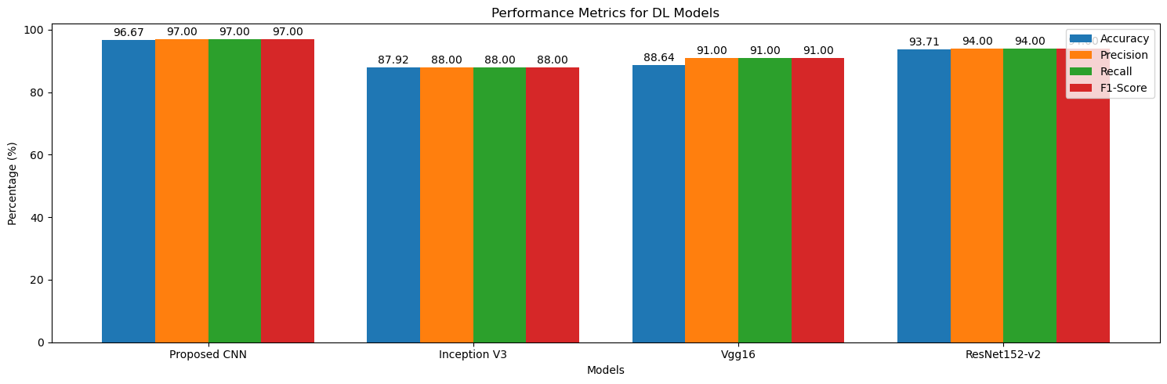
Results & Evaluation
Figure 9: Graphical presentation of proposed CNN and other DL model’s performance
Our proposed CNN model achieved higher precision compared to other DL models which is 97%.
Our proposed CNN model achieved higher recall compared to other DL models which is also 97%.
Our proposed CNN model achieved higher accuracy compared to other DL models which 96.67% .

Slide 22
Precision , Recall, F1 Score
Model | Precision | Accuracy | Specificity (True negative rate) | Sensitivity (True positive rate) | F1- score
Proposed CNN | 97% | 96.11% | 97% | 97% | 97%
ResNet152-v2 | 93.71% | 94% | 94% | 94% | 94%
VGG16 | 88.64% | 91% | 91% | 91% | 91%
Inception-v3 | 87.92% | 88% | 88% | 88% | 88%
Table 8: Precision, Recall, F1 Score table
Our proposed CNN model achieved higher accuracy, and precision compared to other DL models which are 96.11% and 97%.
ResNet152-v2 achieved higher accuracy and precision then VGG16 and Inception-v3 which are 93.71% and 94%.
We also observe that VGG16 achieved a good result with 88.64% accuracy.
Throughout the research we find that Inception-v3 achieved the lowest result in all matrices of performance.

Slide 23
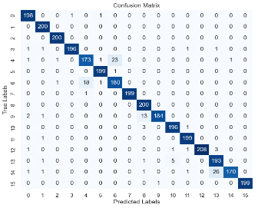
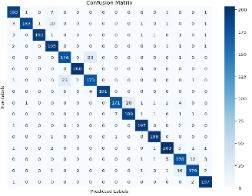
Confusion Metrix
A confusion matrix is a performance evaluation tool in machine learning, representing the accuracy of a classification model.
It displays the number of true positives, true negatives, false positives, and false negatives.
This matrix aids in analyzing model performance, identifying mis-classifications, and improving predictive accuracy.
Figure 10: Confusion Matrix of Proposed CNN
Figure 11: Confusion Matrix of RestNet152-v2

Slide 24
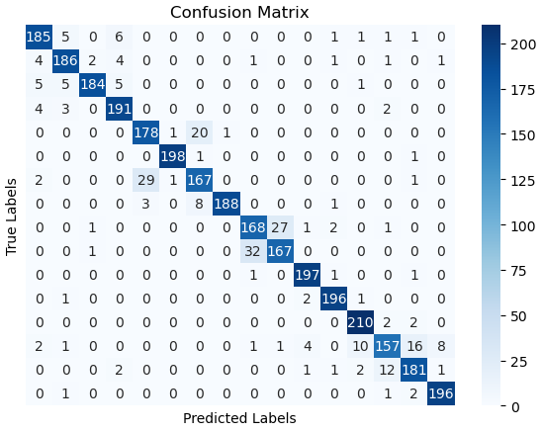
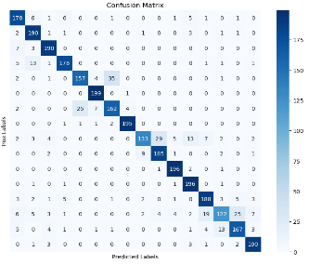
Continue
Figure 12: Confusion Matrix of Proposed VGG16
Figure 13: Confusion Matrix of Inceptionn-v3
We have tested out models using 200 test images in each class.
Our proposed CNN model provides 100% correct prediction on four classes and those are class 1 apple_black_rot class 2 Apple_Cedar_apple_rust class 8 Grape_Black_rot and class 12 Tomato_Bacterial_spot.

Slide 25
ROC-AUC Curve
The ROC (Receiver Operating Characteristic) curve is like a graph that shows how good a model is at telling things apart. A graphical plot illustrating the trade-off between True Positive Rate and False Positive Rate at various classification thresholds.
AUC (Area Under the Curve): A single metric representing the overall performance of a classification model based on the area under its ROC curve. A higher AUC value, closer to 1.0, indicates superior performance. The best possible AUC value is 1.0, corresponding to a model that achieves 100% sensitivity and 100% specificity.
True Positive Rate (Sensitivity): Proportion of actual positives correctly identified by the model.
False Positive Rate: The model incorrectly classifies the proportion of actual negatives as positives.
Specificity (True Negative Rate): Proportion of actual negatives correctly identified by the model.

Slide 26
Continue
Figure 14: ROC-AUC curve (a) Proposed CNN, (b) ResNet152-v2, (c) VGG16, and (d) Inception-v3
Here we plot the ROC curve for the given class against the rest. Plot the ROC curves for each class on the same graph. Each curve represents the discrimination performance of the model for a specific class. Examine the AUC scores for each class. A higher AUC score indicates better discrimination for that particular class.

Slide 27
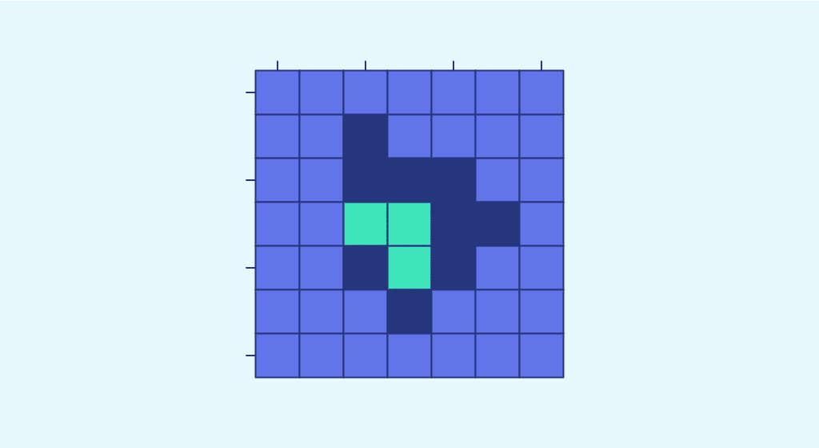
Explainable AI visualization
Grad-CAM
The gradient-weighted class activation map (Grad CAM) produces a heat map that highlights important regions of an image using the target gradients (dog, cat) of the final convolutional layer.
The Grad CAM method is a popular visualization technique that is useful for understanding how a convolutional neural network has been driven to make a classification decision.
Layer-CAM
Layer-CAM is a class activation map (CAM) method used to visualize which parts of an input image are contributing to a neural network's prediction, with an emphasis on activation in individual layers rather than relying only on the final convolutional layer.
It's a more refined method than Grad-CAM, as it can generate better localization of regions by focusing on the activations of intermediate layers.

Slide 28
Continue
Fig 15: (a) Grad-Cam Vs (b) Layer-Cam Visualization
In our research we compared Grad-CAM and Layer-CAM to visualize the focus of CNN in plant disease detection, as shown in Figure.
In contrast, Layer-CAM improves upon Grad-CAM by incorporating activations from multiple convolutional layers, offering more detailed and precise visualizations.

Slide 29
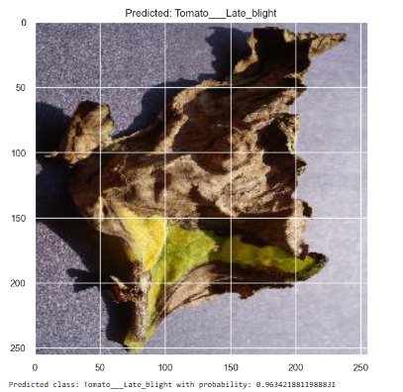
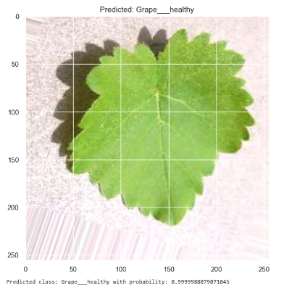
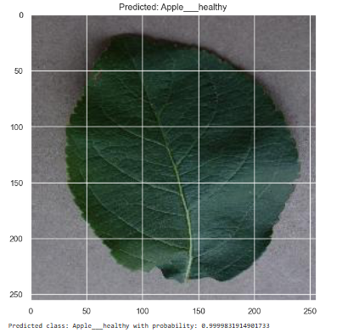
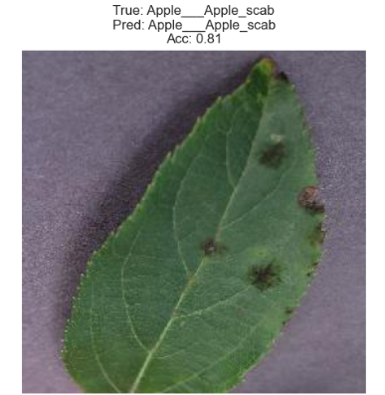
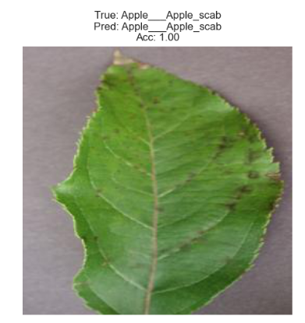
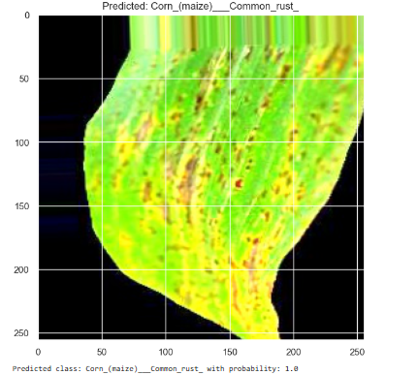
Test-Result With Seen Data
Fig 16: Test Result Seen Data

Slide 30
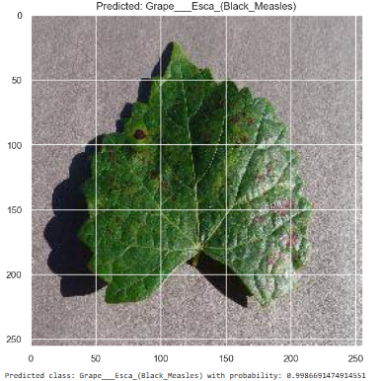
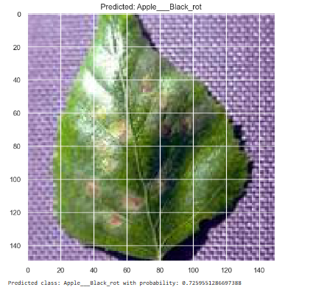
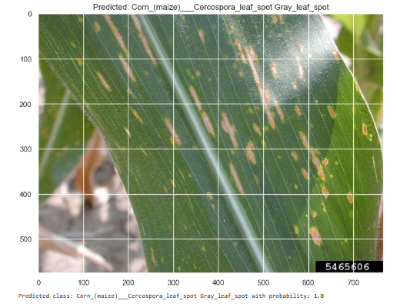
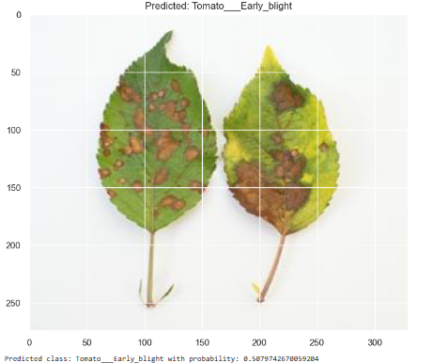
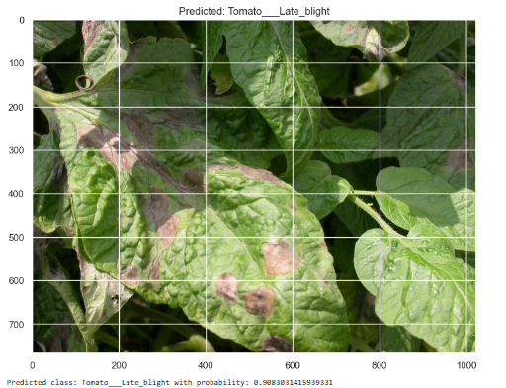
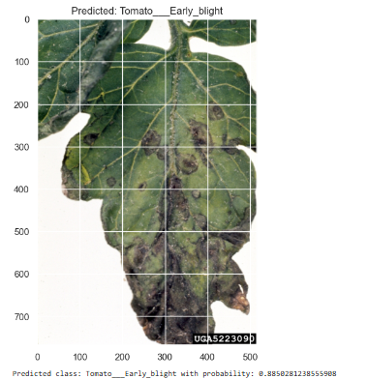
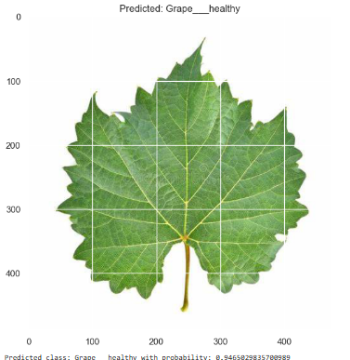
Test-Result With Unseen Data
Fig 17: Test Result With Unseen Data

Slide 31
Conclusion
Introduced a custom-designed CNN model for plant leaf disease classification using deep learning techniques.
Improved model accuracy and reliability through data augmentation and image normalization.
Outperformed existing methods with superior accuracy, precision, recall, and F1-score.
Performance analysis using ROC curves and confusion matrices confirmed the model’s high classification ability.
Demonstrated the model’s potential to set new standards in plant disease detection, providing reliable diagnostic insights.

Slide 32
Future Work
Further refinement of the CNN architecture to enhance classification accuracy.
Exploration of hybrid models integrating various deep learning techniques for improved results.
Incorporating explainable AI methods (e.g., Layer-CAM) to improve model transparency and trust.
Development of user-friendly, real-time plant disease detection applications.
Focus on making advanced diagnostic tools accessible to farmers in resource-limited settings.

Slide 33
References
Deep Learning for Plant Disease Detection Munaf Mudheher Khalid, Oguz Karan Altinbas University, 34217 İstanbul, Turkiye malmoudher97@gmail.com; oguz.karan@altinbas.edu.tr
A Review on Machine Learning Classification Techniques for Plant Disease Detection Mrs. Shruthi U CSE Department AcIT Bengaluru, India soft.shruthi@gmail.com Dr. Nagaveni V CSE Department AcIT Bengaluru, India. nagaveni@acharya.ac.in
Deep learning models for plant disease detection and diagnosis Konstantinos P. Ferentinos Hellenic Agricultural Organization “Demeter”, Institute of Soil & Water Resources, Dept. of Agricultural Engineering, 61 Dimokratias Av., 13561 Athens, Greece
Image-Based Tomato Leaves Diseases Detection Using Deep Learning Belal A. M. Ashqar, Samy S. Abu-Naser Department Information Technology, Faculty of Engineering and Information Technology, Al-Azhar University, Gaza, Palestine
Multi-Class Breast Cancer Classification using Deep Learning Convolutional Neural Network Majid Nawaz, Adel A. Sewissy, Taysir Hassan A. Soliman Faculty of Computer and Information, Assiut University
Plant Disease Detection and Classification by Deep Learning A Review LILI LI1, SHUJUAN ZHANG 2,ANDBINWANG 2 1College of Information Science and Engineering, Shanxi Agricultural University, Jinzhong 030800, China 2College of Agricultural Engineering, Shanxi Agricultural University, Jinzhong 030800, China Corresponding author: Shujuan Zhang (zsujuan1@163.com)
Plant Disease Detection Using Image Processing and Machine Learning Pranesh Kulkarni1, Atharva Karwande1, Tejas Kolhe1, Soham Kamble1, Akshay Joshi1, Medha Wyawahare1

Slide 34
Thank You.

